Slide 1


Publishing house
«MIF»
BI_LAB2017 DWH
December 2,2017

Slide 2

BUSINESS BACKGROUND
Издательский дом «МИФ»
Город: Москва
Дата основания: 2005 год.
Основатели: Игорь Манн, Михаил Иванов и Михаил Фербер
Специализация: издание книг по маркетингу и менеджменту, управлению временем
Если самую умную мысль уныло завернуть и никому не показывать, она ничего не изменит.

Slide 3

Dimensions of a Business
Бизнес-процес: учет продаж изданных книг.
Зерно: Одна строка из таблицы фактов представляет собой одну транзакцию в чеке: определенную книгу, которую работник продал потребителю в конкретном магазине в какой-либо день со скидкой (или без), а также каким способом осуществлялась оплата.

Slide 4
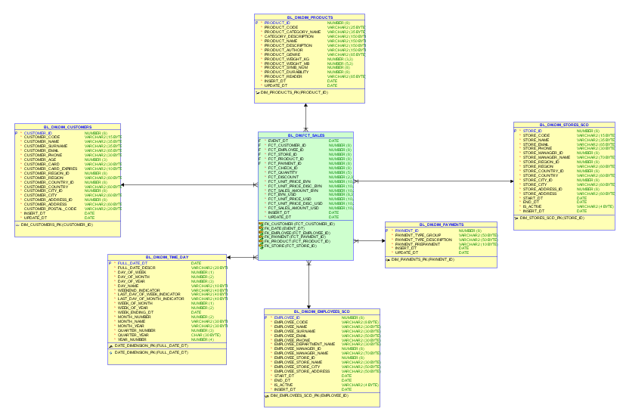
STAR SCHEMA

Slide 5
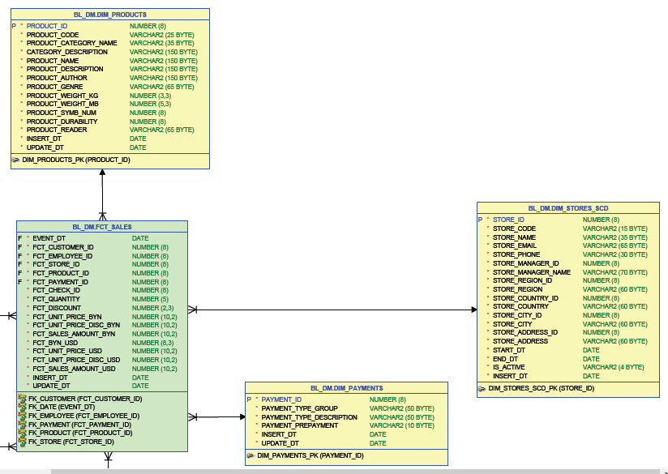
STAR SCHEMA

Slide 6
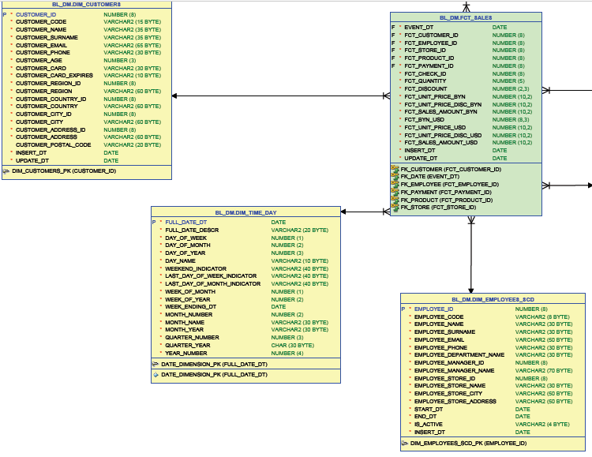
STAR SCHEMA

Slide 7
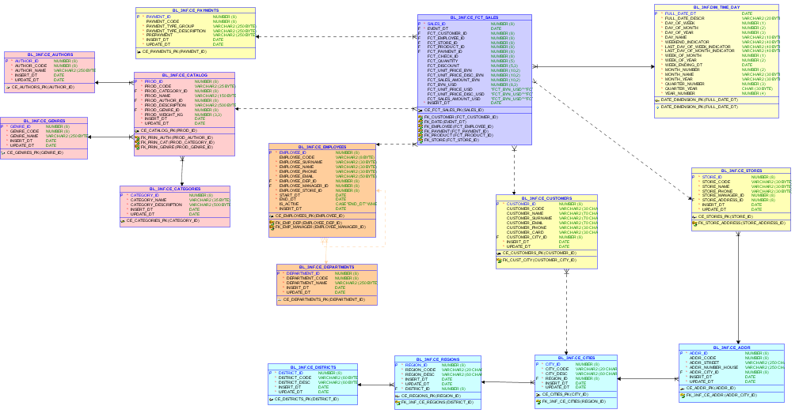
3NF SCHEMA

Slide 8
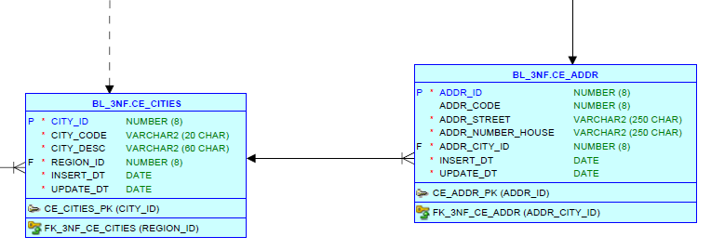
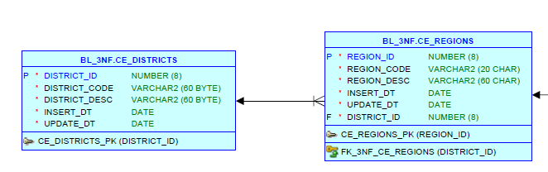
GEODATA

Slide 9
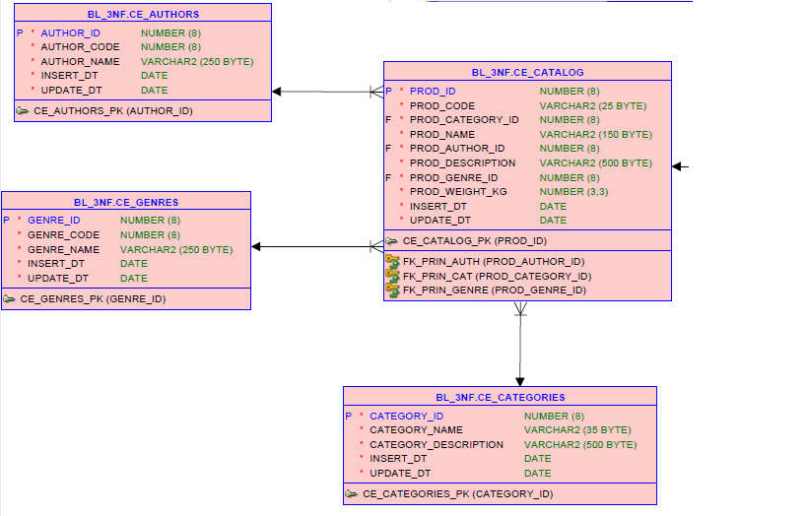
CATALOG

Slide 10
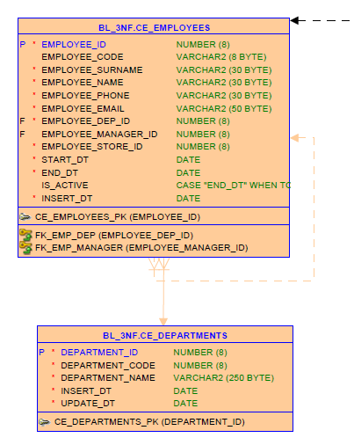
EMPLOYEES

Slide 11
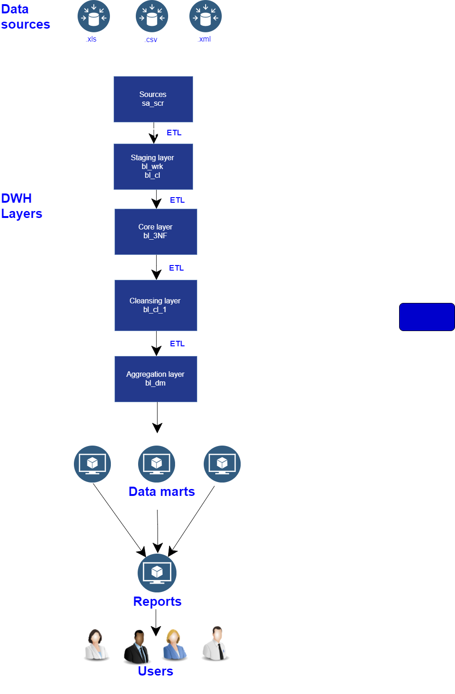
DATA FLOW

Slide 12
DATA FLOW

Slide 13

SOURCES
Геоданные – Excel file
Клиенты - http://www.fakenamegenerator.com
Работники -https://ebaza.pro/category/7.
Отделы – вручную
Магазины – официальный сайт изд-ва «МИФ»
Каталог - выслал технический директор
издательского дома «МИФ»

Slide 14
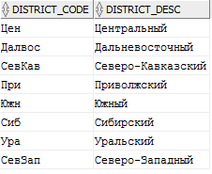
SRC CODE
CASE
WHEN (INSTR(district_name,'-', 1, 1)>0 )
THEN SUBSTR(district_name,1,3)
||SUBSTR(district_name,(INSTR(district_name,'-', 1, 1)+1),3)
WHEN LENGTH(district_name)>13
THEN SUBSTR(district_name,1,3)
||SUBSTR(district_name,7,3)
WHEN district_name='Сибирский'
THEN 'Сиб'
WHEN district_name='Приволжский'
THEN 'Привлж'
WHEN district_name='Уральский'
THEN 'Урал'
ELSE SUBSTR(district_name,1,3)
END AS code,

Slide 15
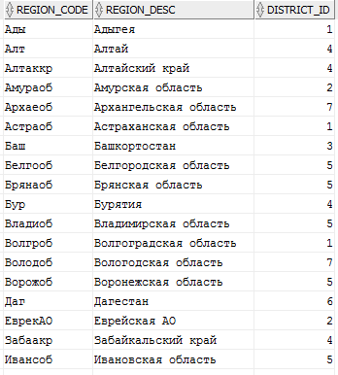
SRC CODE
CASE
WHEN (INSTR(region_name,' ', 1, 1)>0 )
THEN SUBSTR(region_name,1,4)||SUBSTR(region_name,7,1)
||SUBSTR(region_name,(INSTR(region_name,' ', 1, 1)+1),2)
WHEN (INSTR(region_name,'-', 1, 1)>0 )
THEN SUBSTR(region_name,1,3)
||SUBSTR(region_name,(INSTR(region_name,'-', 1, 1)+1),3)
ELSE SUBSTR(region_name,1,3)
END AS region,

Slide 16
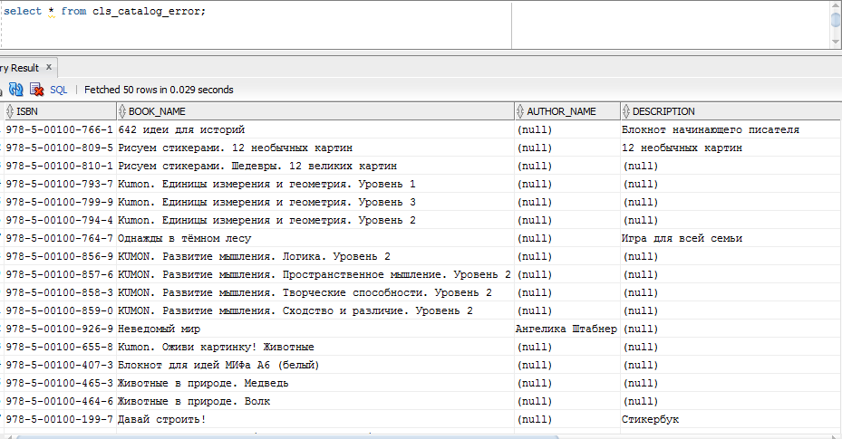
FEATURES: ERROR TABLES

Slide 17

FEATURES: BULK COLLECT/EXPLICIT CURSOR
LOOP
FETCH c_data bulk collect INTO t_data limit 10000;
EXIT
WHEN t_data.count = 0;
FOR i IN t_data.first .. t_data.last
LOOP
IF t_data(i).author_name IS NULL OR t_data(i).isbn IS NULL OR t_data(i).genre IS NULL THEN
INSERT
INTO cls_catalog_error VALUES
(
t_data(i).isbn,
t_data(i).book_name,
t_data(i).author_name,
t_data(i).description,
t_data(i).genre,
t_data(i).weight
);
acc_err := acc_err+ SQL%ROWCOUNT;
ELSE

Slide 18
FEATURES: FACT GENERATING
1.
2.
BEGIN
i :=dbms_random.value(1,20);
result:=
CASE
WHEN i<=10 THEN
CEIL(dbms_random.value(a,b))
WHEN i>10 AND i<=16 THEN
CEIL(dbms_random.value(b,c))
WHEN i>16 AND i<=19 THEN
CEIL(dbms_random.value(c,d))
WHEN i<20 THEN
CEIL(dbms_random.value(d,e))
ELSE
'1'
END ;
IF RESULT=0
THEN RETURN(2);
ELSE
RETURN(result);
END IF;
BEGIN
result:=0;
EXECUTE IMMEDIATE 'SELECT MAX('||col_name||') FROM '||table_name INTO v_max;
i :=dbms_random.value(1,10);
result:=
CASE
WHEN i<=7 THEN
CEIL(dbms_random.value(1,(v_max*0.45)))
WHEN i>7 AND i<=9 THEN
CEIL(dbms_random.value((v_max*0.45),(v_max*0.97))) WHEN i<10 THEN
CEIL(dbms_random.value((v_max*0.97),(v_max*1))) ELSE
'1'
END ;
IF RESULT=0
THEN RETURN(2);
ELSE
RETURN(result);
END IF;
END;

Slide 19
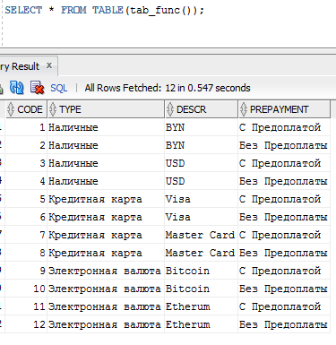
FEATURES: TABLE FUNCTION
FUNCTION tab_func
RETURN Paym_func PIPELINED
IS
CURSOR p
IS
SELECT * FROM wrk_payment ;
out_rec Paym_type := Paym_type(NULL,NULL,NULL,NULL);
in_rec p%ROWTYPE;
BEGIN
OPEN p;
LOOP
FETCH p
INTO in_rec;
EXIT
WHEN p%NOTFOUND;
out_rec.code := in_rec.code;
out_rec.type :=in_rec.type;
out_rec.descr := in_rec.descr;
out_rec.prepayment := in_rec.prepayment;
PIPE ROW(out_rec);
END LOOP;
CLOSE p;
RETURN;
END;

Slide 20
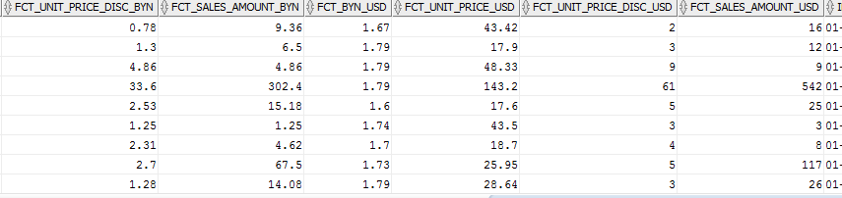
FEATURES: VIRTUAL COLUMNS
Fct_unit_price_disc_BYN generated always
AS
(Fct_unit_price_BYN*Fct_discount), Fct_sales_Amount_BYN generated always
AS
(Fct_unit_price_BYN*Fct_discount *Fct_quantity ) , Fct_BYN_USD NUMBER(8,3) , Fct_unit_price_USD generated always
AS
(Fct_BYN_USD * Fct_unit_price_BYN), Fct_unit_price_disc_USD generated always
AS
(CEIL(Fct_BYN_USD * Fct_unit_price_BYN*Fct_discount)) , Fct_sales_Amount_USD generated always
AS
(CEIL(Fct_BYN_USD * Fct_unit_price_BYN*Fct_discount *Fct_quantity )),

Slide 21
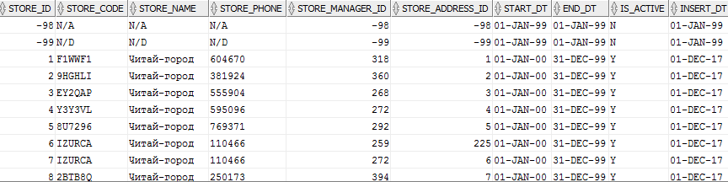
FEATURES: VIRTUAL COLUMNS
is_active AS (
CASE
WHEN end_dt=to_date('31-DEC-9999')
THEN 'Y'
ELSE 'N'
END) ,

Slide 22
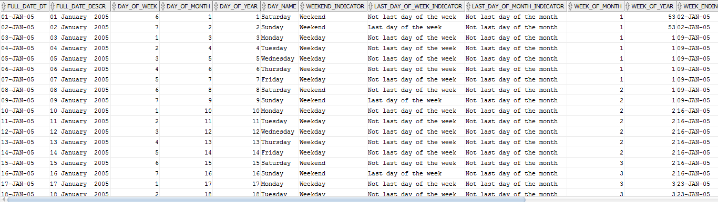
DIM_TIME_DAY
BEGIN
v_CURRENT_DATE := TO_DATE('0101' || v_START_YEAR, 'MMDDYYYY');
v_END_DATE := TO_DATE('1231' || v_END_YEAR, 'MMDDYYYY');
TO_CHAR(v_CURRENT_DATE,'FMDay'), --DAY_NAME
CASE --LWEEKend_INDICATOR
WHEN TO_CHAR(v_CURRENT_DATE,'FMDay') = 'Saturday'
OR TO_CHAR(v_CURRENT_DATE,'FMDay') = 'Sunday'
THEN 'Weekend'
ELSE 'Weekday'
END,
v_CURRENT_DATE := v_CURRENT_DATE + 1;
EXECUTE sp_DATE_DIMENSION(2005,2045);

Slide 23
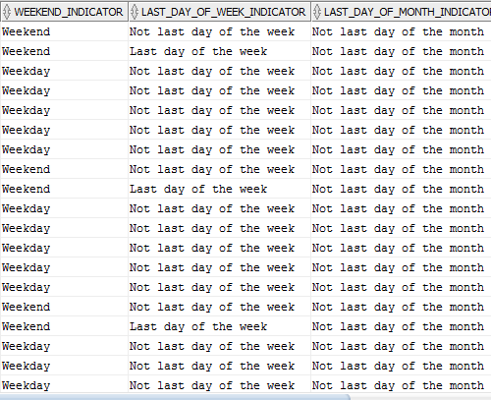
DIM_TIME_DAY: FLAGS
Cryptic abbreviations, true/false flags, and operational indicators should be supplemented
in dimension tables with full text words that have meaning when
independently viewed.
R.Kimball

Slide 24

PARTITIONING: PARTITION TEMPLATE
PARTITION BY RANGE
(
event_dt
)
SUBPARTITION BY LIST (Fct_store_dist_id)
SUBPARTITION TEMPLATE
(SUBPARTITION south VALUES ('1') TABLESPACE tbs1,
SUBPARTITION fareast VALUES ('2') TABLESPACE tbs2,
SUBPARTITION volga VALUES ('3') TABLESPACE tbs3,
SUBPARTITION siberia VALUES ('4') TABLESPACE tbs4,
SUBPARTITION centr VALUES ('5') TABLESPACE tbs5,
SUBPARTITION northcauc VALUES ('6') TABLESPACE tbs6,
SUBPARTITION northwest VALUES ('7') TABLESPACE tbs7,
SUBPARTITION ural VALUES ('8') TABLESPACE tbs8
)

Slide 25
PARTITIONING: DATE
PARTITION sales_2005_2010 VALUES LESS THAN (TO_DATE('01-JAN-2010','dd-Mon-yyyy')),
PARTITION sales_2010_2011 VALUES LESS THAN (TO_DATE('01-JAN-2011','dd-Mon-yyyy')),
PARTITION sales_2011_2012 VALUES LESS THAN (TO_DATE('01-JAN-2012','dd-Mon-yyyy')),
PARTITION sales_2012_2013 VALUES LESS THAN (TO_DATE('01-JAN-2013','dd-Mon-yyyy')),
PARTITION sales_2013_2014 VALUES LESS THAN (TO_DATE('01-JAN-2014','dd-Mon-yyyy')),
PARTITION sales_2014_2015 VALUES LESS THAN (TO_DATE('01-JAN-2015','dd-Mon-yyyy')),
PARTITION sales_2015_2016 VALUES LESS THAN (TO_DATE('01-JAN-2016','dd-Mon-yyyy')),
PARTITION sales_2016_2017 VALUES LESS THAN (TO_DATE('01-JAN-2017','dd-Mon-yyyy')),
PARTITION sales_2017_2018 VALUES LESS THAN (TO_DATE('01-JAN-2018','dd-Mon-yyyy')),
PARTITION sales_2018_2019 VALUES LESS THAN (TO_DATE('01-JAN-2019','dd-Mon-yyyy')),
PARTITION sales_2019_2020 VALUES LESS THAN (TO_DATE('01-JAN-2020','dd-Mon-yyyy')),
PARTITION sales_2020_2021 VALUES LESS THAN (TO_DATE('01-JAN-2021','dd-Mon-yyyy')),
PARTITION sales_2021_more VALUES LESS THAN (maxvalue)

Slide 26
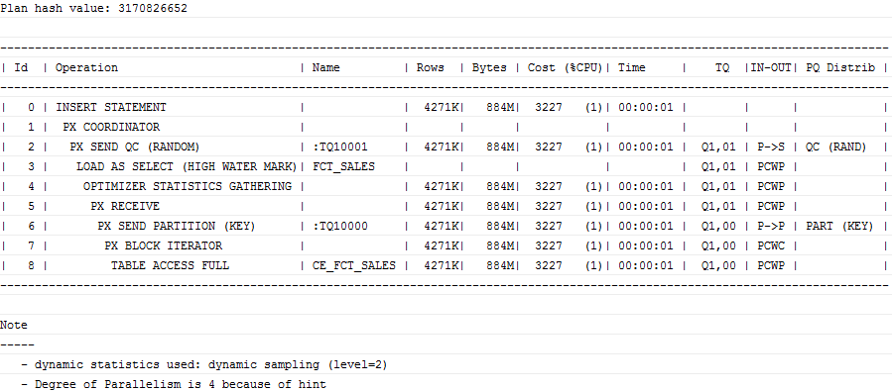
PARALLEL INSERT

Slide 27

BATCH FILE
CONNECT BL_CL/123456;
show user;
@D:\MIF\bl_cl\tables\wrk_addresses;
@D:\MIF\bl_cl\tables\wrk_catalog_print;
@D:\MIF\bl_cl\tables\wrk_customers;
@D:\MIF\bl_cl\tables\wrk_departments;
@D:\MIF\bl_cl\tables\wrk_employees;
@D:\MIF\bl_cl\tables\wrk_geodata;
@D:\MIF\bl_cl\tables\wrk_payment;
@D:\MIF\bl_cl\tables\wrk_stores;
@D:\MIF\bl_cl\tables\cls_addr;
@D:\MIF\bl_cl\tables\cls_authors;
@D:\MIF\bl_cl\tables\cls_catalog;
@D:\MIF\bl_cl\tables\cls_category;
@D:\MIF\bl_cl\tables\cls_cities;
@D:\MIF\bl_cl\tables\cls_customers;
@D:\MIF\bl_cl\tables\cls_departments;
@D:\MIF\bl_cl\tables\cls_districts;
@D:\MIF\bl_cl\tables\cls_employees;
@D:\MIF\bl_cl\tables\cls_fct_sales;
@D:\MIF\bl_cl\tables\cls_genre;
@D:\MIF\bl_cl\tables\cls_regions;
@D:\MIF\bl_cl\tables\cls_stores;
@D:\MIF\bl_cl\create_seq;

Slide 28
BI-LAB2017 DWH
PROJECT OVERVIEW BY Saida Melikava
student

